Slide 1
The right to a full life: survival and healthy development for all children grand rounds sydney children’s hospital randwick
Megan Mitchell
National Children’s Commissioner
9 October 2013
Notes:
Acknowledgments.

Slide 2
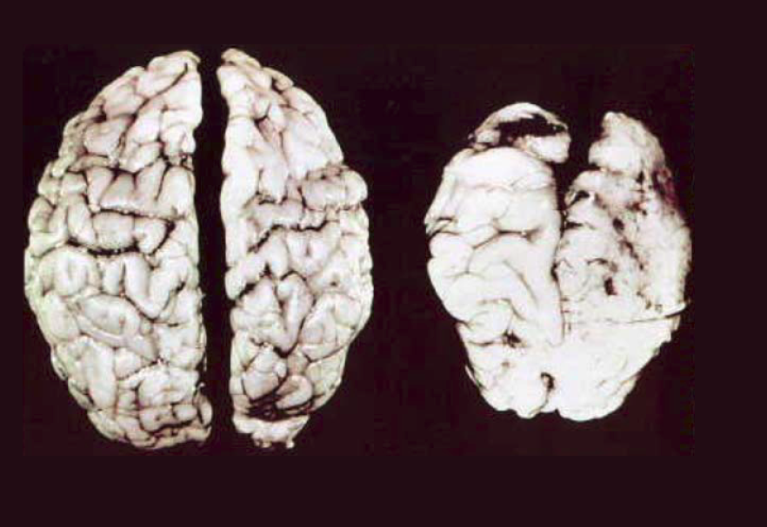
Optimal survival and development begins before birth .
6 Week Old Baby
“Normal” brain
6 Week Old Baby
“Foetal Alcohol Syndrome” brain
T Kellerman, FAS Community Resource Center Prenatal Alcohol Exposure and the Brain. At http://www.come-over.to/FAS/FASbrain.htm (viewed 20 September 2013).

Slide 3
Damage caused by Foetal Alcohol Spectrum Disorders (FASD)
Infants
Low birth weight/poor growth
Irritability
Sensitivity to light, noises and/or touch
Feeding problems
Failure to thrive
Toddlers
Memory problems
Hyperactivity
Lack of fear
Poor sense of boundaries
Impairment of gross or fine motor skills
Children
Poor growth and developmental delay
Problems with vision
Language and speech deficits
Memory problems and poor judgment
Birth defects
Improperly formed bodies and organs
Social and behavioural problems
Cognitive problems
Sleeping difficulties
Hyperactivity and impulsiveness
Difficulty concentrating
Problems with abstract thinking
Difficulty forming and maintaining relationships
P Walker, To study models of care for children with Foetal Alcohol Syndrome, 2008, p 7.

Slide 4
FASD is not a black and white issue
… it is intertwined with a complex web of interrelated socio-economic factors, including poverty, alienation, isolation, domestic violence, other substance-related issues, and decades of the poisoning of culture by alcohol. Regular, frequent and excessive alcohol consumption is so entrenched in some places that is has become the norm. This applies to both Indigenous and non-Indigenous populations.
Anyinginyi Health Aboriginal Corporation, Submission to the House of Representatives Standing Committee on Social Policy and Legal Affairs Inquiry into the Prevention, Diagnosis, and Management of Fetal Alcohol Spectrum Disorders (November 2012).

Slide 5
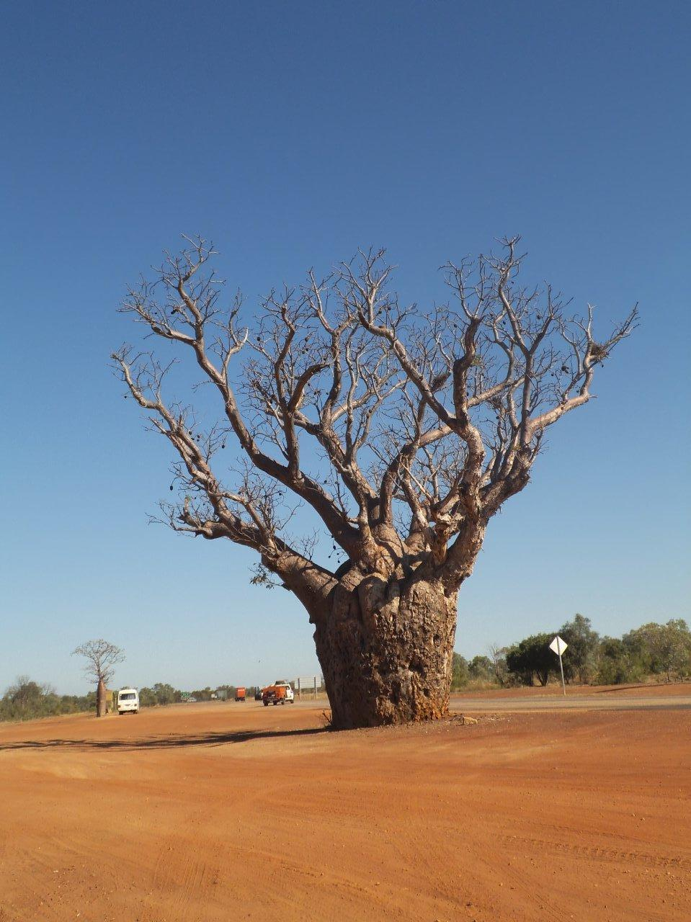
The Lililwan Project is for all the little ones …
Lililwan means “for all the little ones” – after 13 suicides in 13 months, commonplace family violence and high rates of alcohol use in pregnancy, Aboriginal women in Western Australia’s Fitzroy Valley lobbied to ban full-strength ‘takeaway’ alcohol and developed their own strategy for the diagnosis and prevention of FASD.
The Lililwan Project recognises that prevention of FASD is important to optimise health and development for future generations of Aboriginal children and to ensure the transfer of culture and language from one generation to the next.
E Elliott, J Latimer, J Fitzpatrick, J Oscar & M Carter, ‘There’s hope in the valley’ (2012) 48(3) Journal of Paediatrics and Child Health 190.

Slide 6
Article 6
States Parties recognise that every child has the inherent right to life.
States Parties shall ensure to the maximum extent possible the survival and development of the child.
Article 24
States Parties recognise the right of the child to the enjoyment of the highest attainable standard of health and to facilities for the treatment of illness and rehabilitation of health. States Parties shall strive to ensure that no child is deprived of his or her right of access to such health care services.
When read together, articles 6 and 24 oblige government to systematically identify the risks and protective factors that underlie children’s health, life, survival and development.
Committee on the Rights of the Child, General Comment No. 15 – on the Right of the Child to the Enjoyment of the Highest Attainable Standard of Health, CRC/C/GC/15 (2013), para 16. At http://www2.ohchr.org/english/bodies/crc/docs/GC/CRC-C-GC-15_en.doc (viewed 20 September 2013).

Slide 7
Evidence-informed interventions must address the whole range of health determinants of a child’s life
Age
Sex
Educational attainment
Socioeconomic status
Family environment
Access to services and support
Violence that threatens the life and survival of children
Drug and alcohol abuse
Government policies and administrative structures
Social and cultural norms
Poverty
Alienation
Isolation
A child-rights approach to health obliges government to design and implement evidence-informed interventions that systematically address the whole range of health determinants during the life course of the child.
Committee on the Rights of the Child, General Comment No. 15, para 16.

Slide 8
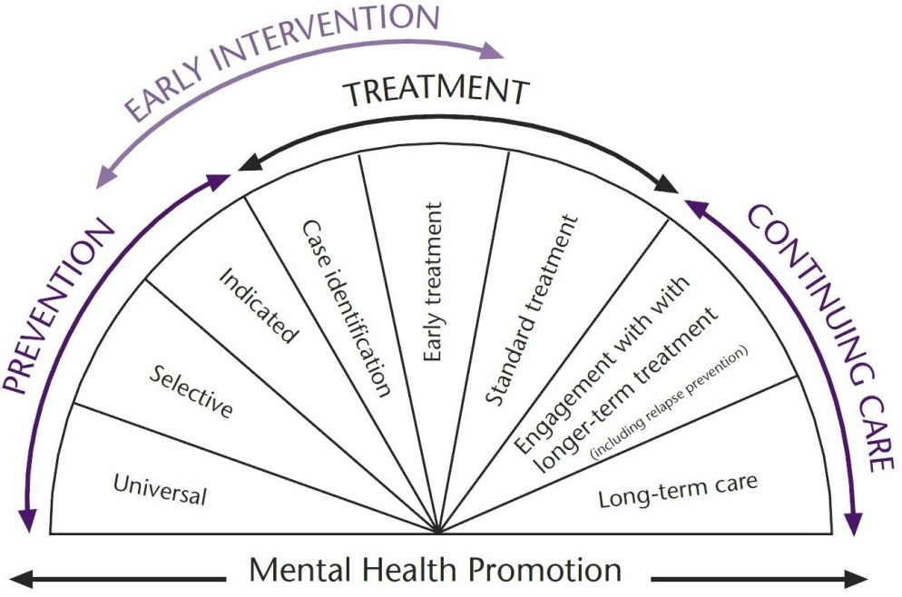
Mental health interventions need to help grow healthy children, not just treat mental illness
The CRC gives to every child the right to:
The highest attainable standard of health, including mental wellbeing
Facilities for treatment of illness and rehabilitation, including for children with mental health issues
The right of access to such health care services
Adapted from Mrazek and Haggerty (1994).
Committee on the Rights of the Child, General Comment No. 15, para 39.

Slide 9
Understanding the social determinants of mental and physical health in Australia
The science of early childhood development shows that brain development is highly sensitive to external influences in early childhood, starting in utero, with lifelong effects.
The conditions to which children are exposed, including the quality of relationships and language environment, literally ‘sculpt’ the developing brain. Raising healthy children means stimulating their physical, language/cognitive, and social/emotional development.
Healthy development during the early years provides the essential building blocks that enable people to lead a flourishing life in many domains, including social, emotional, cognitive, and physical wellbeing.
Commission on the Social Determinants of Health, Closing the Gap in a Generation: Health equity through action on the social determinants of health, World Health Organisation, Geneva, 2008, p 50.

Slide 10
A child-rights approach seeks to address the underlying social determinants of mental health
Access to health care
Lack of available or acceptable services
Economic barriers to care
Consequences
Impact of depression on productivity
Social consequences of depression
Cost of depression treatment
Lifestyle consequences of depression
Vulnerability
Early developmental risks
Maternal mental illness
Developmental risks for adolescence
Exposure
Violence/crime
Social fragmentation
Injury prevention
Poor neighbourhoods
Unemployment
Socioeconomic context and position
Lack of government policy and legislation; human rights framework
Substance abuse
Stigma
Unemployment
Work stress
Lack of education
Commission on the Social Determinants of Health, Closing the Gap in a Generation, p 98.

Slide 11
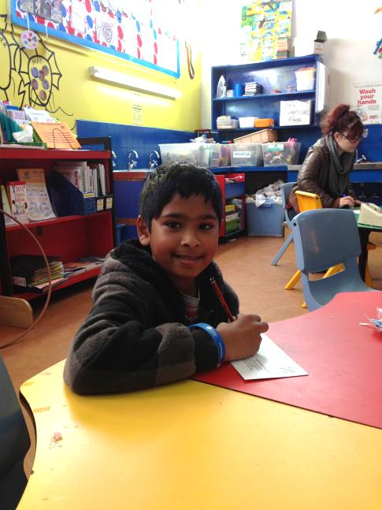
A child-rights approach to chronic disease
Early childhood nutrition is important for an infant’s survival, growth and development, and to enhance health throughout the lifecycle. For infants, it provides many health benefits, including reducing the risk of infection, asthma, allergies and sudden infant death syndrome. It also helps to improve cognitive development and protection against obesity an chronic diseases in later life.
Australian Institute of Health and Welfare, Australia’s Health 2012, p 192.

Slide 12
Article 12 gives to every child the right to be taken seriously on all aspects of health
… including, for example, what services are needed, how and where they are best provided, barriers to accessing or using services, the quality of the services and the attitudes of health professionals, how to strengthen children’s capacities to take increasing levels of responsibility for their own health and development, and how to involve them more effectively in the provision of services, as peer educators.
Committee on the Rights of the Child, General Comment No. 15, para 19.

Slide 13
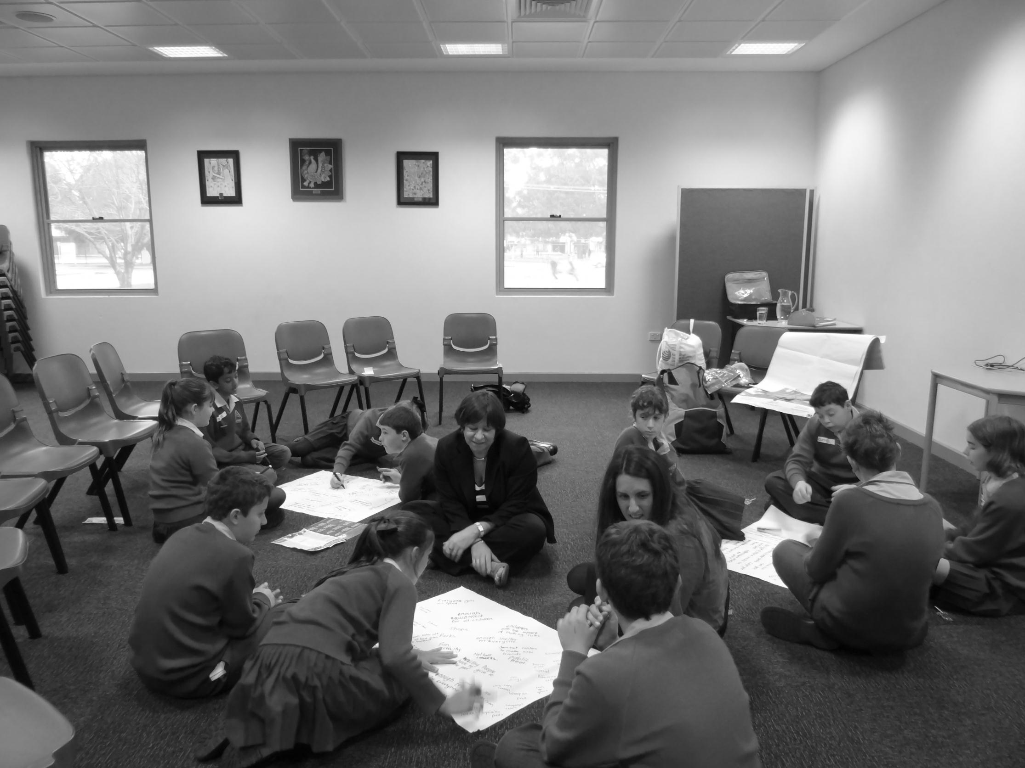
What do children themselves say?
All kids should be treated fairly
All children should have equal access to education
Life would be better if there was no drugs or bad stuff
I think that everyone should be safe
All children should be cared for
We should all be able to access services like headspace
I am happiest when my family is happy and healthy
Young people should have sexual health clinics
Every child should have healthy food
There should be no violence
There should be no bullies
There should be housing for everyone
Everyone should have a family

Slide 14
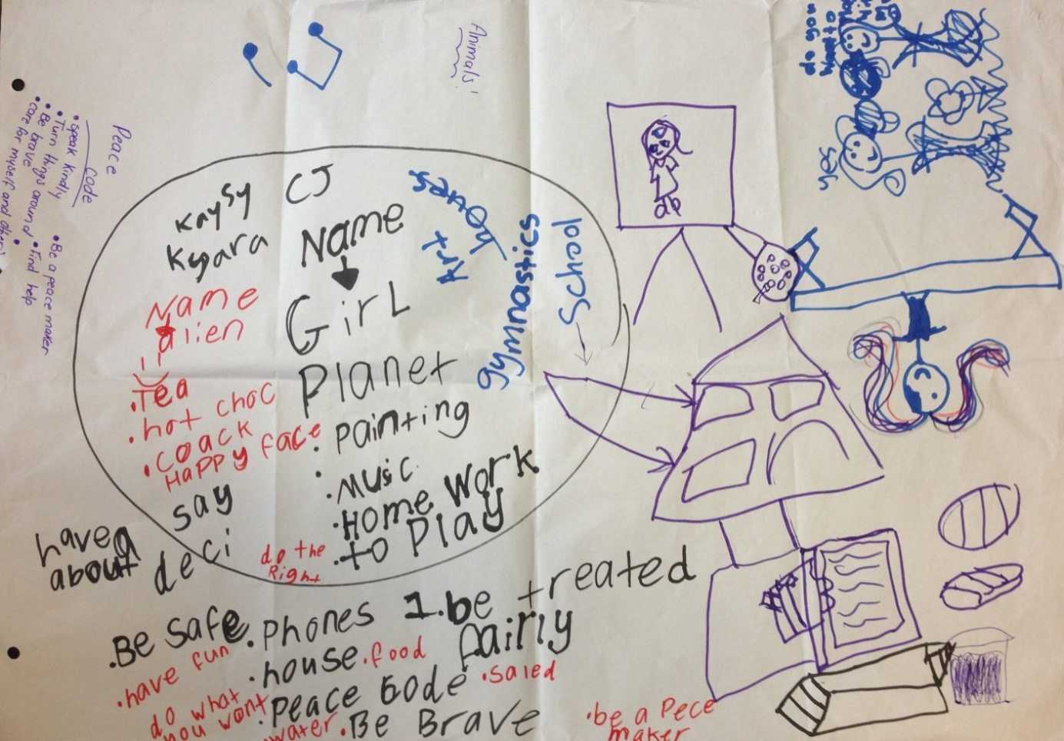
Northfield OSHC, SA
Photo of drawings by children at Northfield OSHC, SA (10 July 2013)

Slide 15
Berry Street alternative care, VIC
“
Life would be better for children if everyone had houses to live in. .
”
Photo of drawings by children at Berry Street alternative care, VIC (4 July 2013)

Slide 16
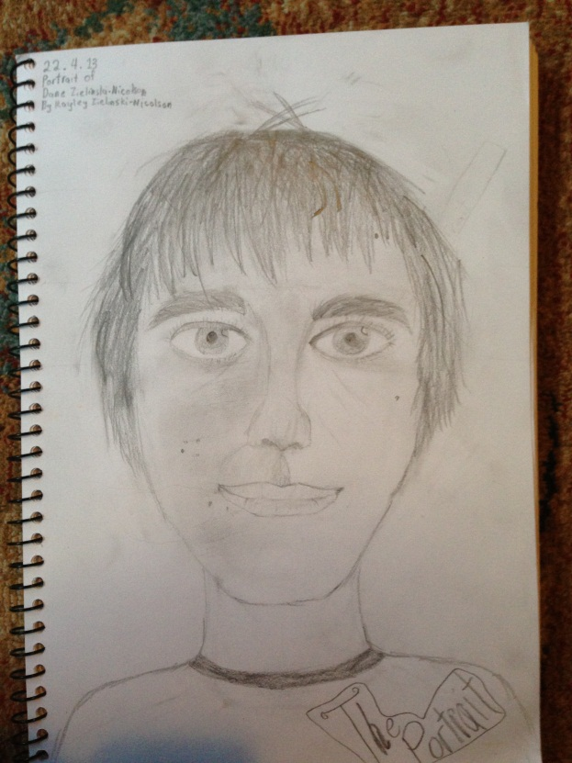
Albert Park Flexi School, QLD
“
Life would be better if we were not pushed into the mental health too hard basket. .
”
Photo of a portrait drawn by a child (22 April 2013)

Slide 17
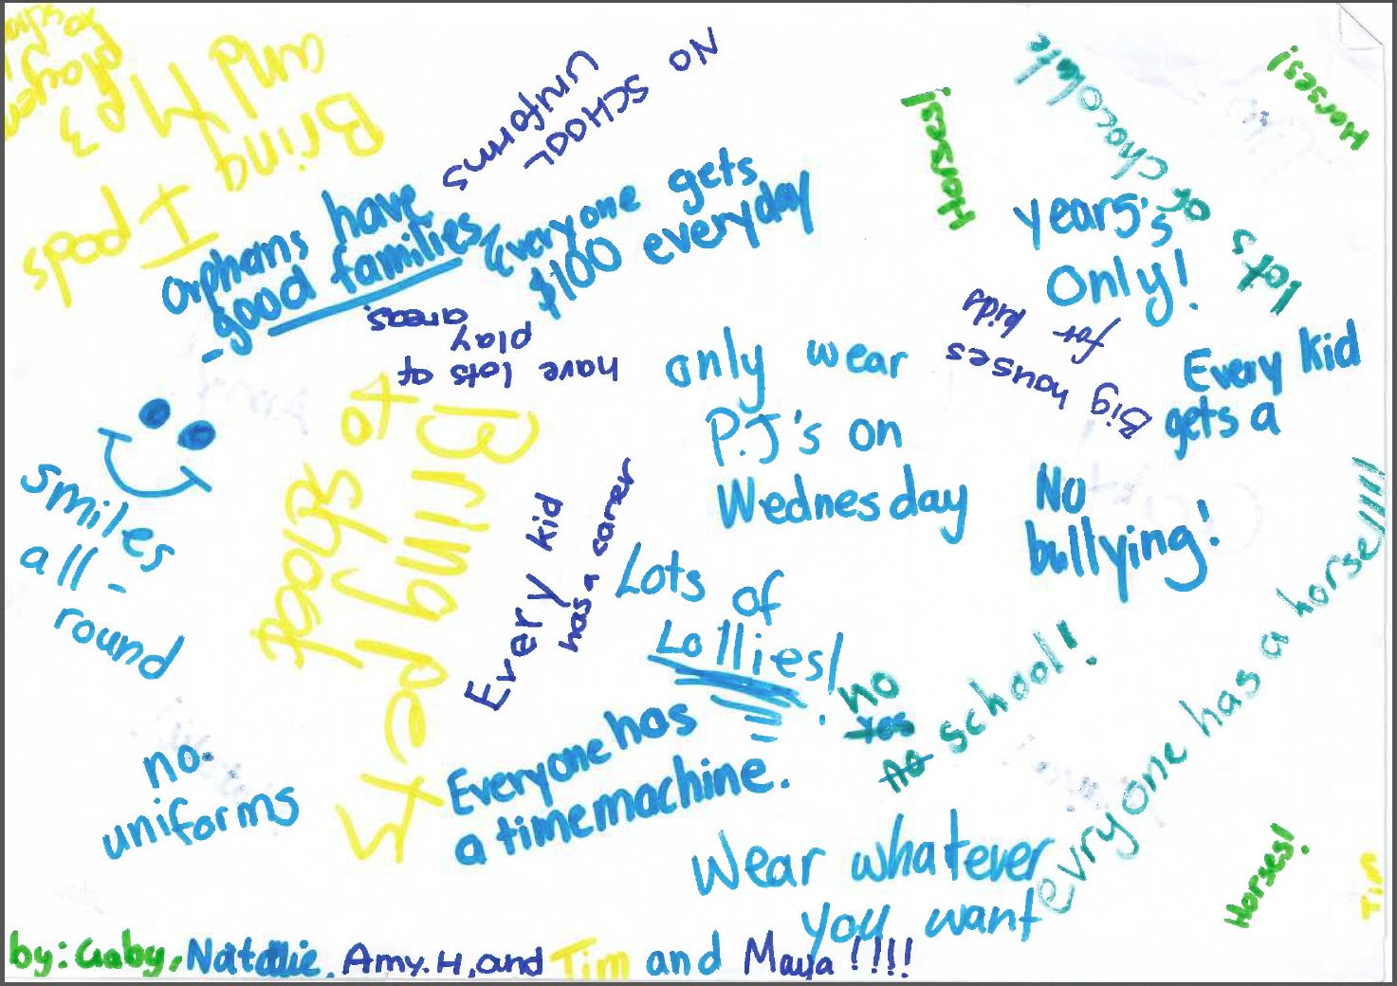
Burgmann OSHC, ACT
Photo of drawings by children at Burgmann OSHC, ACT (30 May 2013)

Slide 18
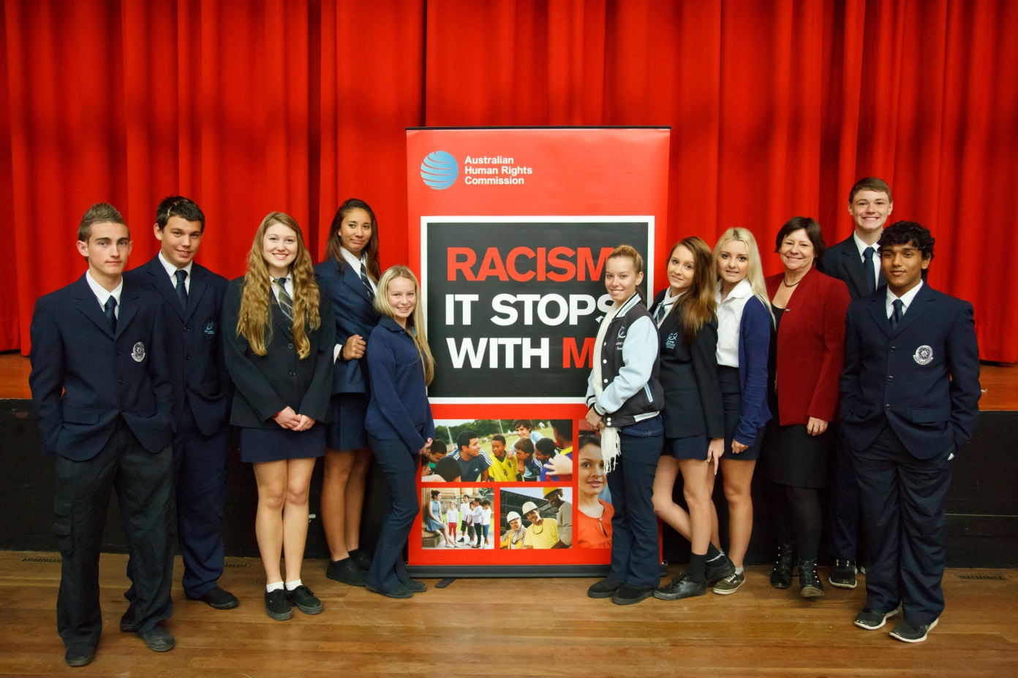
James Meehan High School, NSW
Photo of Commissioner Mitchell and children at James Meehan High School, NSW (12 June 2013)

Slide 19
Belyuen Primary School, NT
“
The roads should be good so we can get around.
”
Photo of Commissioner Mitchell and children at Belyuen Primary School, NT (7 August 2013)

Slide 20
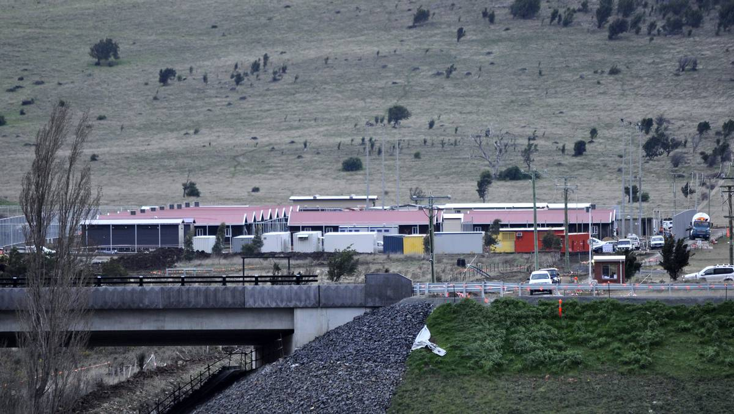
Pontville Alternative Place of Detention, Tas
Photo of Pontville Alternative Place of Detention, Tas, by Calla Wahlquist, The Examiner (30 January 2013)

Slide 21
Youth Affairs Council of Victoria, VIC
Photo of drawings by children at YACVIC (30 September 2013)

Slide 22
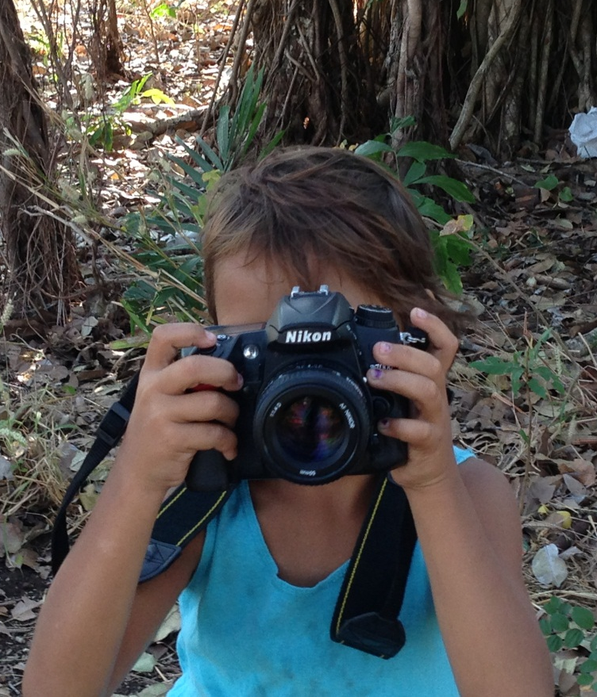
We must elevate children’s rights by privileging their voices
6 Week Old Baby
“Normal” brain
6 Week Old Baby
“Foetal Alcohol Syndrome” brain
Photo of a child from the Big Banter

