Slide 1
Safeguarding the mental health of children and ensuring the opportunity to thrive – themes emerging from the Big Banter Meeting of the Community Reference Group (Advisory group to the RCH Mental Health) Royal Children’s Hospital Melbourne CHECK AGAINST DELIVERY
Megan Mitchell
National Children’s Commissioner
18 March 2014
Notes:
Acknowledgments.

Slide 2
Legislative functions
submitting a report to the Minister as soon as practicable after 30 June in each year
promoting discussion and awareness of matters relating to the human rights of children in Australia
undertaking research, or educational or other programs, for the purpose of promoting respect for the human rights of children in Australia, and promoting the enjoyment and exercise of human rights by children in Australia
examining existing and proposed Commonwealth enactments for the purpose of ascertaining whether they recognise and protect the human rights of children in Australia, and to report to the Minister the results of any such examination.

Slide 3
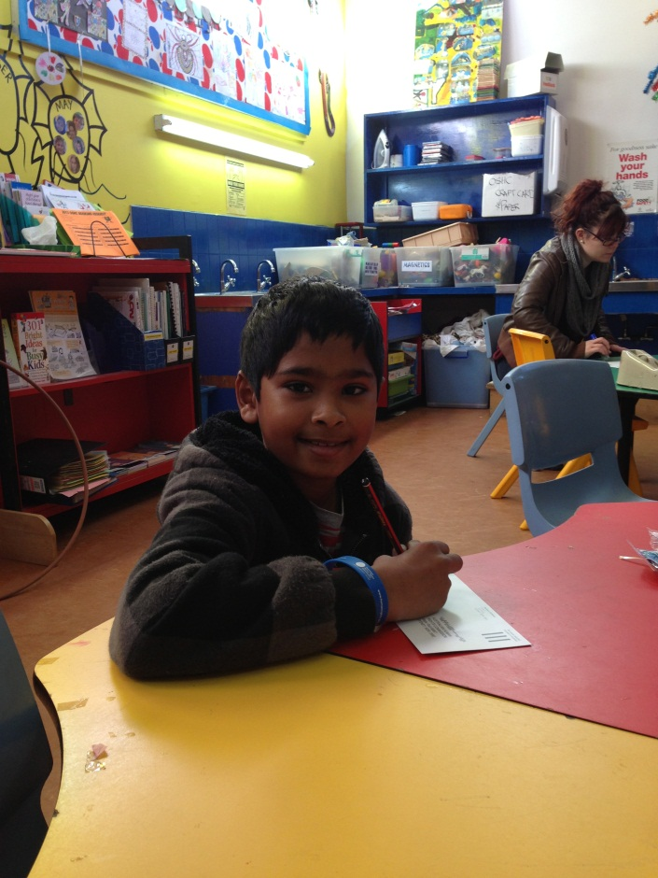
Article 12 – the right to be heard
States Parties shall assure to the child who is capable of forming his or her own views the right to express those views freely in all matters affecting the child, the views of the child being given due weight in accordance with the age and maturity of the child.
For this purpose, the child shall in particular be provided the opportunity to be heard in any judicial and administrative proceedings affecting the child, either directly, or through a representative or an appropriate body, in a manner consistent with the procedural rules of national law.
Photo of a child from the Big Banter

Slide 4
The Big Banter email: kids@humanrights.gov.au

Slide 6
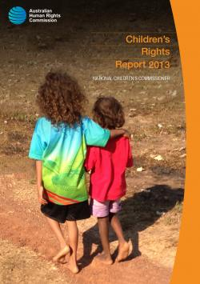
Children’s Rights Report 2013

Slide 7
Five emerging themes from the Children’s Rights Report
A right to be heard
Freedom from violence, abuse and neglect
The opportunity to thrive
Engaged citizenship
Action and accountability

Slide 8
Freedom from violence, abuse and neglect Life would be better if nobody got hurt and children felt safe all the time. Life would be better for children and young people in Australia if there was no drugs and violence. I’ve been beaten up and bullied. I complained about it but it didn’t fix the problem. 13 year old child from the Northern Territory Life would be better for children and young people if there was no hitting. Child from Western Australia

Slide 9
The opportunity to thrive I have Asperger’s Syndrome. Life in primary school was very difficult. Life would be better if people that were different, disabilities, races, religions and any other differences, all accepted each other. If there was no bullying. If schools were supportive of kids with disabilities, especially invisible disabilities like Asperger’s Syndrome. 14 year old child from Victoria Life would be better for children and young people in Australia if we were all treated with equality and we were all treated fairly. Life would be better if everyone learned the meaning of freedom. 10 year old child from Victoria Life would be better for children if the government made sure every child had all the rights. I think every child should have food and water. An Australian child

Slide 10
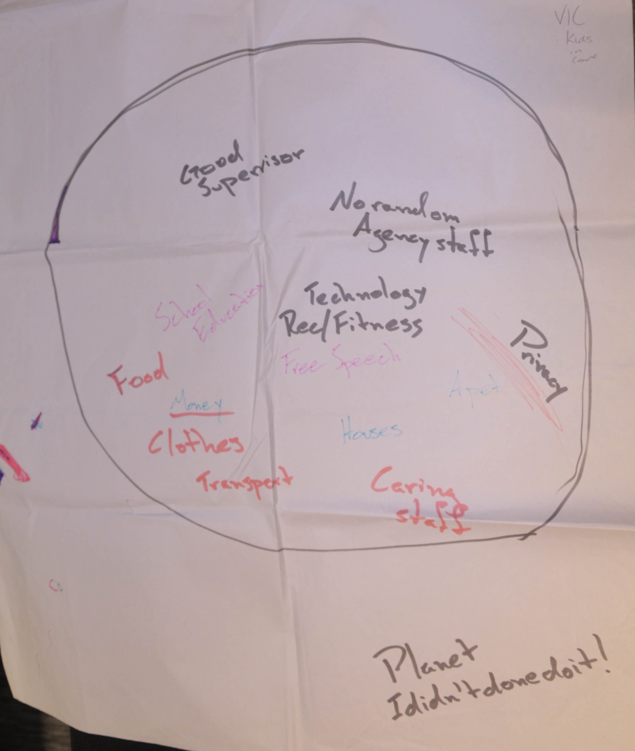

Slide 11
